Slide 1

DiabetesCare
By Team Techbenders

Slide 2





Our team
Maryam Syed
(6623426)
Rabia Sahr
(6142540)
Kaye Lim
(6525325)
Zeyad Hesham
(6287591)
Mahmoud Hamdan
(6320764)

Slide 3
Problem
Diabetes affects around 422 million people globally and it is directly responsible for 1.5 million fatalities per year. (Diabetes 2022)
Many people at risk of developing diabetes are not aware of their risk or do not know how to modify their diet and lifestyle to prevent the onset of the condition.

Slide 4
Solution

Slide 5

(Self-Management Web App)

Slide 6
Competitor Analysis
Features | DiabetesCare | Diabetes:M | DiabTrend | Glucose Tracker
Food Log | ✔ | ✔ | ✔ | ✔
Specific calorie plan with recipes | ✔ | ✖ | ✔ | ✖
Exercise Log | ✔ | ✔ | ✔ | ✔
Personalized workout routines | ✔ | ✖ | ✖ | ✖
Mental health journaling | ✔ | ✖ | ✖ | ✖

Slide 7
Competitor Analysis
Features | DiabetesCare | Diabetes:M | DiabTrend | Glucose Tracker
Daily mental health activities | ✔ | ✖ | ✖ | ✖
Glucose and bp tracker | ✔ | ✔ | ✔ | ✔
Medication entry | ✖ | ✔ | ✔ | ✔
Social Media analysis | ✔ | ✖ | ✖ | ✖

Slide 8
Features
Indicators based on Social Media Analysis for:
Physical Activity Habits
Mental Health Habits
Nutritional Habits
Glucose and Blood Pressure tracker
Logging daily meals from diabetic friendly recipe options
Logging daily workout from exercise options
Journal and receive suitable mental health activities

Slide 9

Technology used
TF Machine learning Model
Sckit Learn ML model
Flask Framework
MongoDB

Slide 10
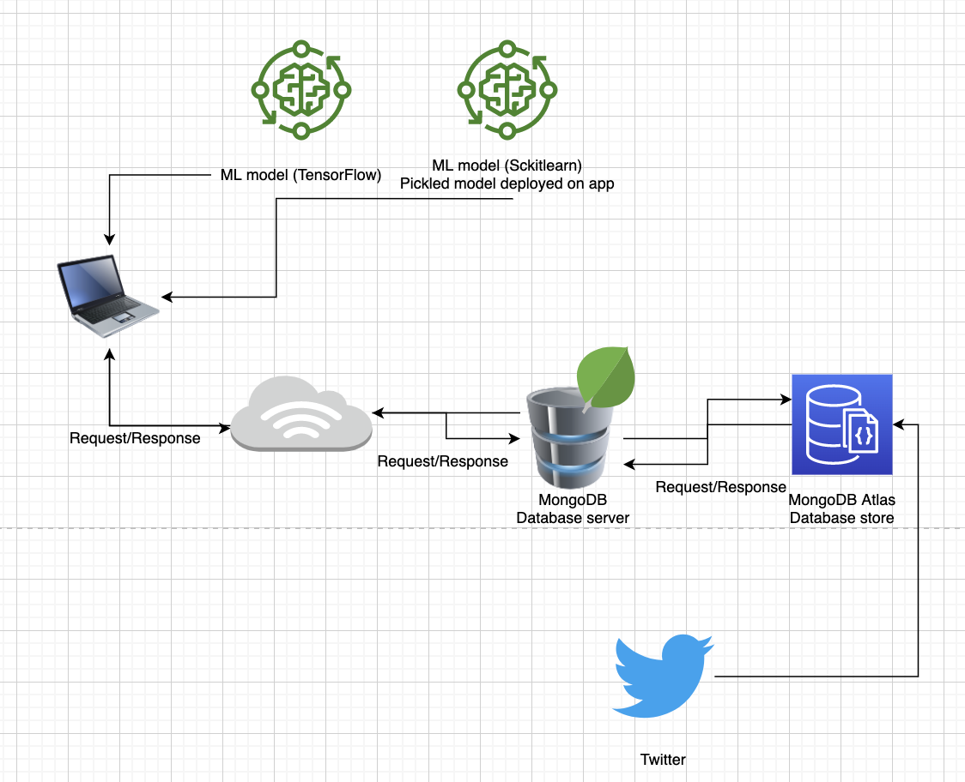
Architecture diagram

Slide 11
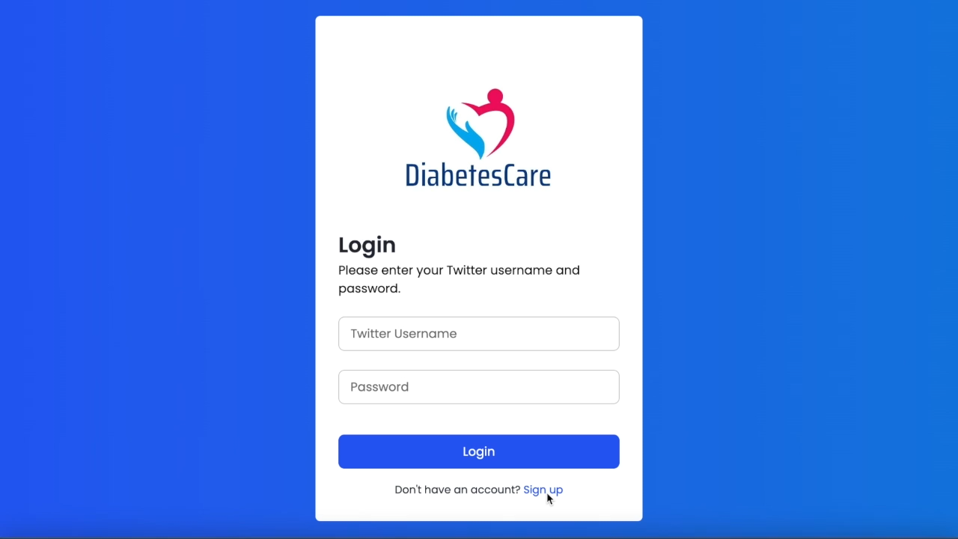
DEMO

Slide 12
Future Elements
Implementation of other social media apps like Instagram and Facebook
Chatbox for user assistance
Medication reminder
Personalized coaching or support from healthcare professionals
Wearable fitness tracking devices to automatically record physical activity data

Slide 13
Reference
Diabetes 2022, World Health Organization, viewed 20 December 2022, <https://www.who.int/news-room/fact-sheets/detail/diabetes>.

Slide 14
Thank You

